Slide 2
Managing stock levels of HIV commodities using electronic systems in Baylor Uganda, Rwenzori region
Joseph Kabanda
Supply Chain Specialist
Share your thoughts on this presentation with #IAS2019

Slide 3
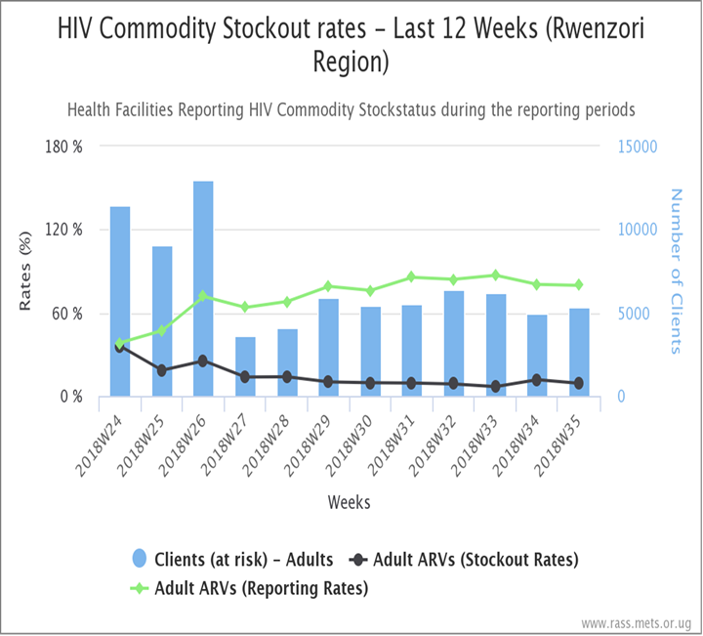
Managing stock levels of HIV commodities using electronic systems in Baylor Uganda, Rwenzori region
Background: Availability of HIV Rapid Test kits and antiretroviral (ARV) medicines are contributing significantly contributed to attainment of the 95-95-95 UNAIDS targets. However, stock levels of HIV commodities in Uganda have been intermittent in the past one year with at least 1-2 commodities getting stocked out. Additionally available stock monitoring techniques have proven to be inaccurate due to the quality of the data and complexity of the tools. We assessed the contribution of using a Real-time ARV Stock Status Monitoring tool (RASS) on stock management in Rwenzori region, Uganda.
Methods: As part of project implementation, a computer based system was developed by METS/CDC to monitor weekly stock levels of ARVs and Rapid Test kits in health facilities. RASS is a dashboard based tool that monitors data on ARV supplies while integrating it with WAOS data (Patient numbers, orders and distributions) for enhanced decision making. Health workers were trained on use of the manual tool, SMS reporting and online reporting. They were also provided with smart electronic reporting devices. District mentors were identified and trained as super users to support and mentor persistently stocked out health facilities. Data used in this analysis was extracted from the RASS dashboard between June and September 2018.

Slide 4
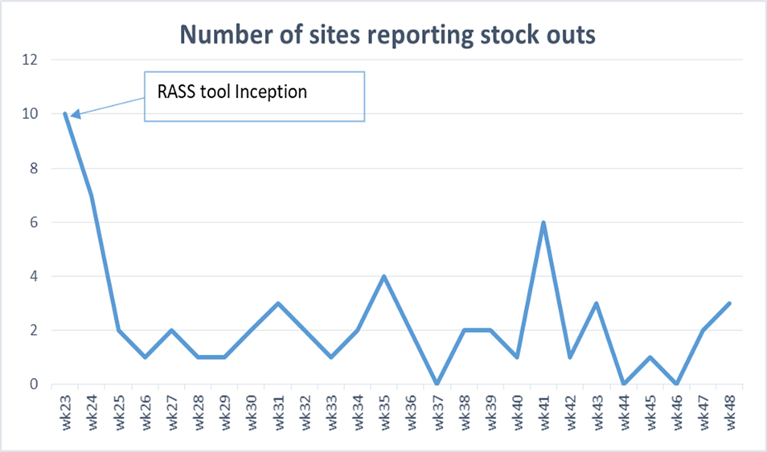
Managing stock levels of HIV commodities using electronic systems in Baylor Uganda, Rwenzori region…Contd
Results: Following the interventions stock out reporting rates of HIV commodities have declined from 13% in January 2018 to <1% in December 2018. Use of the RASS tool has improved stock levels of HIV commodities through evidenced based redistributions/redirection of stock to low stocked health facilities hence combating any eminent stock outs. The program was also able to save close to $130,000 in costs for the ARVs distributed using the RASS tool. The savings came from averted potential wastage and expiries of medicines which would have been underutilised by health facilities.
Conclusions: The RASS tool provides accurate data for better decision making and it’s easy and simple to use to all health workers across the region. Health service interruption was reduced and the country is on course to meet the 95-95-95 UNAIDS targets. Advocacy for other commodities like Anti-TB medicines, OI medicines and tracer EMHS should be added on the RASS tool to reduce the stock out of these commodities in health facilities which impacts on the care and treatment of clients.

Slide 5
CONCLUSION
The electronic system uses both the stock counts of the HIV commodities and the reported number of clients benefiting from that commodity to determine stock levels of the commodity at any time.
The stock levels are shared at a weekly basis enabling health workers to track their stock levels. This guides the health workers to address potential stock outs early hence preventing treatment interruptions.
The electronic system also is very important in programatic implementation to combart any potential misuse or misallocation of HIV commodities and redirecting the stock to potential beneficialiries hence saving on costs of HIV commodities.

